Slide 1
PANIMALAR ENGINEERING COLLEGE
ONLINE PARKING SPACE MECHANISM WITH
PRIVACY PROTECTION
PROJECT DONE BY:
FEMINA S 211418104059
KIRTHIGA N 211418104125
KIRUTHIKA M 211418104126
GUIDED BY:
MRS. S.T. SANTHANALAKSHMI, (ASSISTANT PROFESSOR GRADE I )

Slide 2
INTRODUCTION
In recent years, motor vehicle and non-motor vehicles in small cities is the parking lot is far behind the growth rate of the motor vehicle, resulting in small urban areas especially the demand and the supply of parking facilities, the downtown area of the planning and construction of parking policy and management issues have become increasingly prominent, to solve the parking problem has very urgent. Parking space sharing model is more and more attention at home and abroad, Mou Zhenhua put forward a strategy aimed at reducing the shared parking in the city land use of the city center area, analyzes the feasibility of the shared parking policy. Generation method is proposed to determine the percolation of Sichuan, sharing parking behavior coefficient for domestic actual shared parking demand forecasting model and realize the sharing of parking mode specific implementation measures and policies. Institute of Transportation Engineers (ITE) found more than half of the American local governments have shared parking theory into the local parking management mode, although the practical approach may be used directly or selective use. Related researchers discussed the parking sharing the feasibility of the theory; put forward the application strategy, in the concrete example of application. But the shared parking method is mainly used in the new project berth planning stage, no scholars after the implementation of sharing measures on urban traffic congestion and parking is difficult to solve the problem of the utility is analyzed by a numerical analysis, the utility can be directly obtained by the utility value, easy implementation of shared parking analysis function, providing theoretical support for parking planning and design.

Slide 3
AUTHOR | METHODOLOGY | MAJOR FINDINGS
GuoQingsheng, WengXiaoxiong, SongMinglei | Application of car sharing model is the effective measure to solve the problems. | It defines the concept to solve the traffic congestion utility index & The solve the parking difficulty utility index and has carried on the concrete application of.The application sharing to solve the traffic congestion and parking is difficult to enhance the effectiveness of the obvious conclusion.
Biao Xu, Guojun Da, Zhen Jiang, Jie Wu Peng Liu | PGI schemes, denoted by MDP and spatio temporal assingnment denoted by MDP+. | The unique directive is to solve the forementioned starvation problem in other PGI schemes or similar vehicle dispatching. The contribution is to reduce delay without increasing the facility supply. Both analytical and experimental results demonstrate that our approach can achieve a bounded service, in terms of vehicle cruising time and the overhead cost of information collection and computation.

Slide 4
AUTHOR | METHODOLOGY | MAJOR FINDINGS
Mahmoud M. Badr, Wesam Al Amiri, Mostafa M. Fouda, Mohamed Mahmoud, Abdulah J. Aljohani and Waleed Alasmary | Block chain | The smart parking system can be perfectly applied to all types of vehicles. The internet access can facilitate the communication between vehicle and parking system. Moreover, once a car reaches its reserved parking slot or respective destination, the self-parking functions can be activated to park the car.
Wenhui Zhang, FanGao, ShuruiSun, QiuyingYu, JinjunTang, BohangLiu | Double-objective model | A double-objective model is proposed that considers both the utilizing rate and the walking distance. First, managers want utilize parking resources fully. However, demanders typically choose parking spaces according to convenience. The second objective is the acceptable walking distance from the parking space to the destination. The results demonstrate that the proposed model increases the occupying rates of parking lots in residential zones while decreasing the walking distance.

Slide 5
AUTHOR | METHODOLOGY | MAJOR FINDINGS
Xin Huang, Xueqin Long, Jianjun Wang, LanHe | Shared parking allocation model | Simulation methods are used to the analyze the relationship among the parking benefit, proportion of reserved parking, numbers of parking demand, acceptance rate of parking demand and utilization of shared parking spaces.
Oanh Tran Thi Kim, Nguyen H. Tran, Chuan Pham, Tuan LeAnh | An alternating direction method of multipliers (ADMM) based algorithm | 1. Minimizing parking expenses 2. Balancing parking demand among multiple PLs.
Tingting Fu, Peng Liu, Kun Liu, and Peng Li | A homomorphic encryption-based privacy protection matching scheme (PPMS) is introduced and designed. A block algorithm based on the longitude and latitude (BABLL) | Through the security analysis,the scheme is proved to be able to protect the privacy of sensitive information such as location, time, identity of both requestors, and space providers.
Xumin Huang, Peichun Li, Rong Yu, Yuan Wu, Kan Xie, and Shengli Xie | PVEC | Dynamic arrivals of the vehicles and time-varying parking capacity constraints, a DRL approach was specifically proposed to reach the Stackelberg equilibrium in privacy-friendly way. Finally, results are demonstrated that the scheme is effective for high-accuracy parking space

Slide 6
PROBLEM DEFINITION
Nowadays, the availability of parking spaces is far behind the quick rising number of cars. Rather than building more lots, a better way is to share private-owned parking spaces. However, this faces the challenge that users are not willing to expose their privacy to the public. The increasing rate of private car usage in the urban areas as a result of fast-growing economy, derelict policies and subsidies are the main causes making car parking one of the main concerns for transport and traffic management all over the world. The coordination between parking policies and traffic management revealed how parking is becoming a barrier to the through-traffic operation. Also, it is responsible for the inefficient use of available resources, even the decisions are made on an ad-hoc basis while making policy. Hence, it is necessary to understand the parking choice behaviour and actual demand of parking space. By parking the vehicle in public place the vehicle can be claimed by towing person but in this case there is no towing problems and no need to give fine for anything we can park our vehicle with securely. To solve this problem, we propose a new architecture for parking space sharing, into the design of a secure protocol for parking space searching and booking by using maps.

Slide 7
DEVELOPMENT ENVIRONMENT
HARDWARE ENVIRONMENT
PROCESSOR : Intel Core i3.
RAM : 4 GB
MONITOR : 15” COLOR
HARD DISK : 25 GB
SOFTWARE ENVIRONMENT
FRONT END : HTML, CSS, JAVASCRIPT
BACK END : MYSQL, PHP
OPERATING SYSTEM : Windows07
SOFTWARE : NOTEPAD, XAMPP

Slide 8
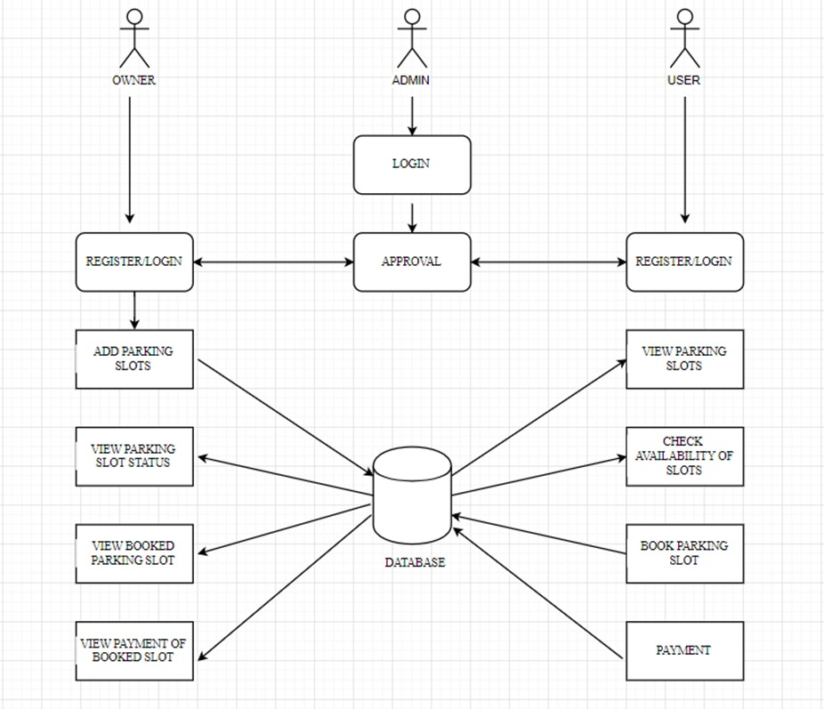
SYSTEM ARCHITECTURE

Slide 9
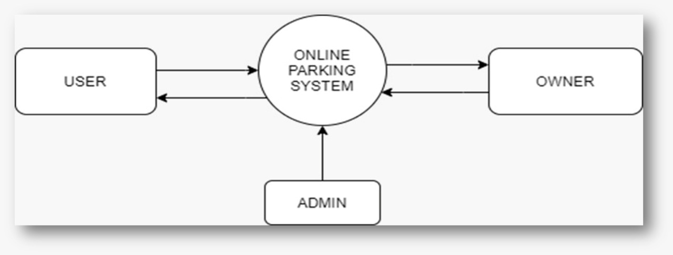
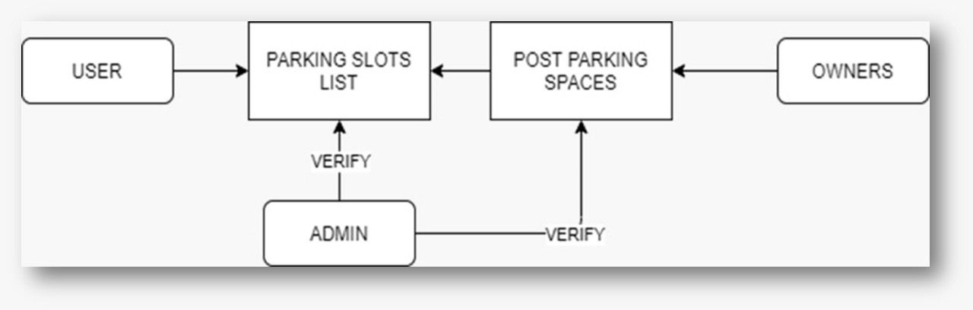
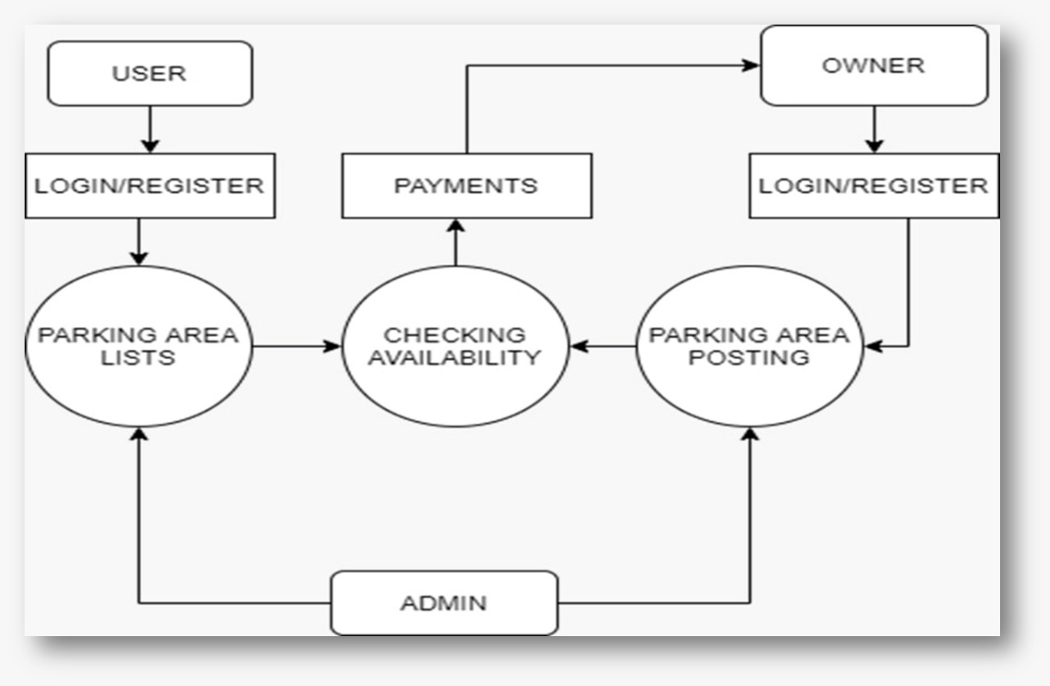
SYSTEM DESIGN
DATA FLOW DIAGRAM
LEVEL 0
LEVEL 1
LEVEL 2

Slide 10
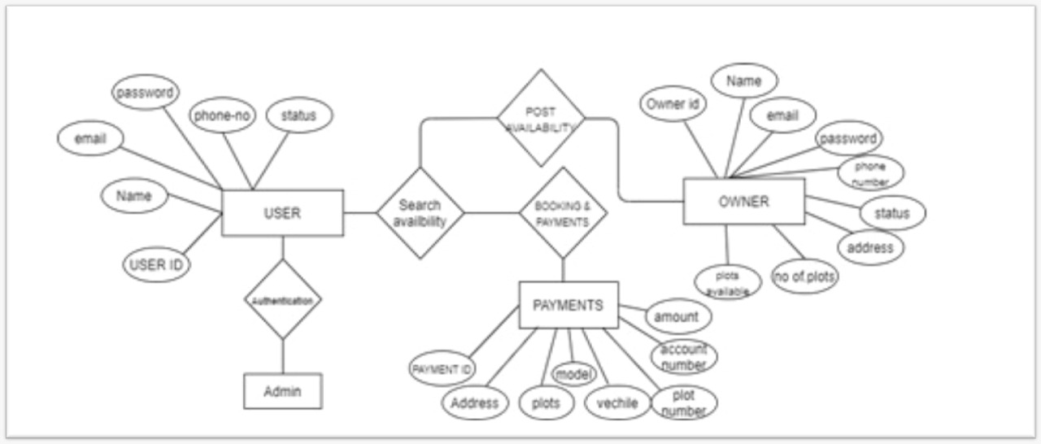
ER DIAGRAM

Slide 11
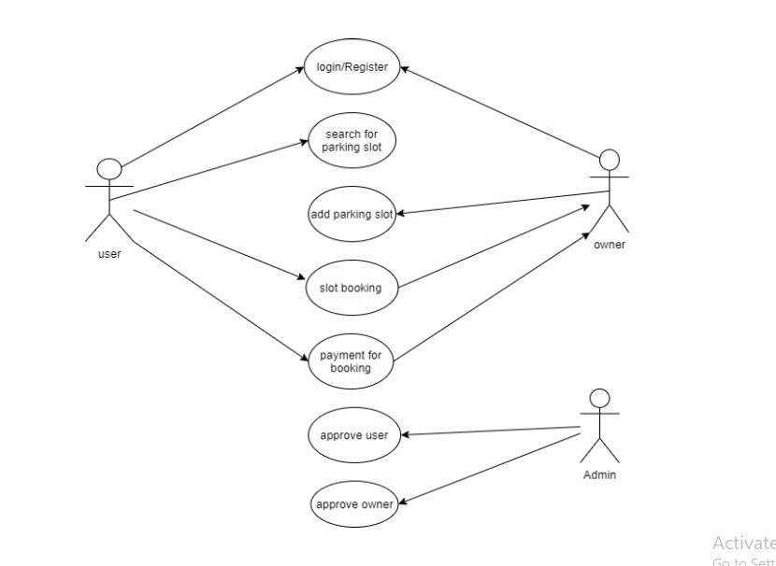
USE CASE DIAGRAM

Slide 12
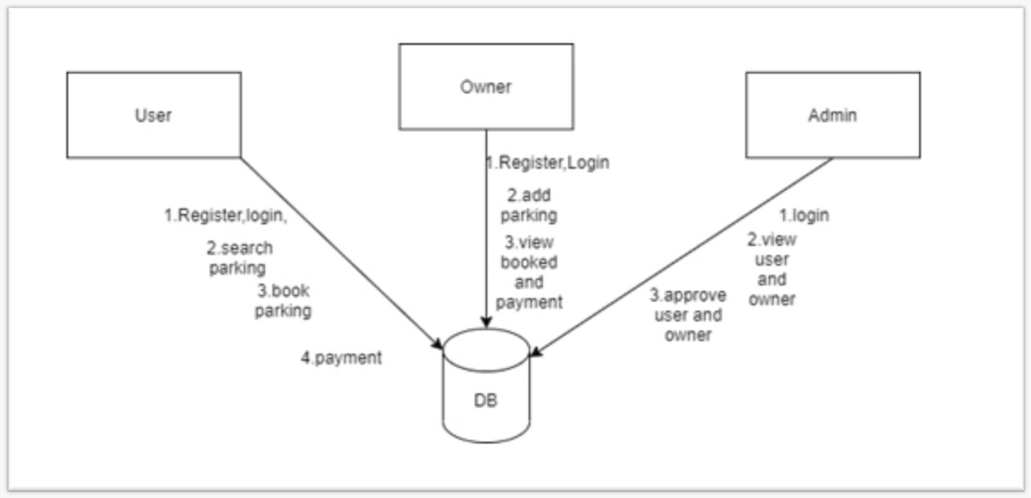
COLLABORATION DIAGRAM

Slide 13
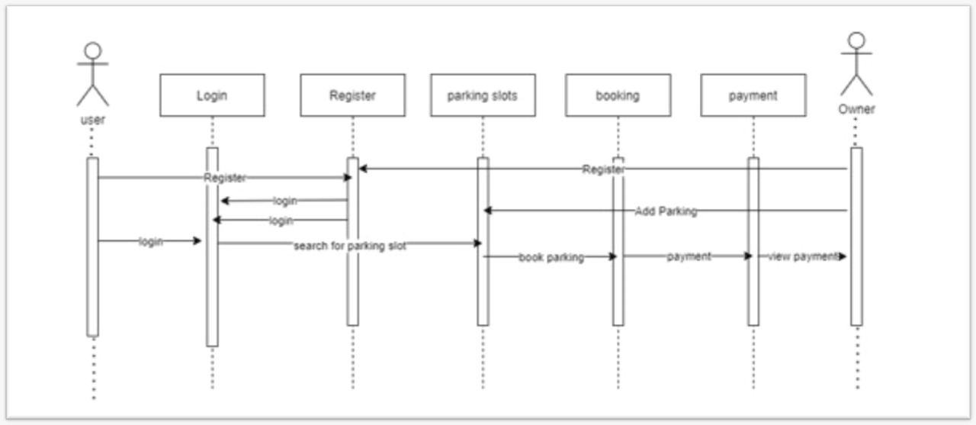
SEQUENCE DIAGRAM

Slide 14
MODULES
LOGIN/REGISTER - MODULE
Registration module is used to register the details about the user. That contain create a unique name and password. That also needs a full name of user and email id of user for authentication. The basic module login is used to web page. The module has username and password. That will be verified with database and allow to login to the web page.
ADMIN - MODULE
This module is used to verify the user, its helps to prevent from the unauthorized problems. Admin add the owners for the parking availability.
USER - MODULE
The user module is used to reserve the parking slots for their purpose and required timing. User can pay the payment for their reserving parking slot, it helps reduce the time and traffic in public place.

Slide 15
OWNER - MODULE
The purpose of owner module is post the availability of their parking areas and allots the parking slot for the specified pre-booking user. Owner can receive the payments from user for reserved parking slots.
PARKING ZONE - MODULE
This module is used to get the get the details of parking slots from the owners and show the parking slots to the users. They can see the empty parking slots whenever chosen areas.
PAYMENT - MODULE
The payment module is used to user pay the deserved amount for the selected parking slots.

Slide 16
PERFORMANCE ANALYSIS
SYSTEM TESTING
The purpose of testing is to discover errors. Testing is the process of trying to discover every conceivable fault or weakness in a work product. It provides away to check the functionality of components, sub-assemblies, assemblies and/or a finished product It is the process of exercising software with the intent of ensuring that the Software system meets its requirements and user expectations and does not fail in an unacceptable manner. There are various types of test. Each test type addresses a specific testing requirement.
INTEGRATION TESTING
Integration tests are designed to test integrated software components to determine if they actually run as one program. Testing is event driven and is more concerned with the basic outcome of screens or fields. Integration tests demonstrate that although the components were individually satisfaction, as shown by successfully unit testing, the combination of components is correct and consistent. Integration testing is specifically aimed at exposing the problems that arise from the combination of components.

Slide 17
FUNCTIONAL TESTING
Functional tests provide systematic demonstrations that functions tested are available as specified by the business and technical requirements, system documentation, and user manuals. Functional testing is centered on the following items:
Valid Input : identified classes of valid input must be accepted.
Invalid Input : identified classes of invalid input must be rejected.
Functions : identified functions must be exercised.
Output : identified classes of application outputs must be exercised.
Systems/Procedures: interfacing systems or procedures must be invoked.
White Box Testing
White Box Testing is a testing in which in which the software tester has knowledge of the inner workings, structure and language of the software, or at least its purpose. It is purpose. It is used to test areas that cannot be reached from a black box level.
Black Box Testing
Black Box Testing is testing the software without any knowledge of the inner workings, structure or language of the module being tested. Black box tests, as most other kinds of tests, must be written from a definitive source document, such as specification or requirements document, such as specification or requirements document. It is a testing in which the software under test is treated, as a black box. you cannot “see” into it. The test provides inputs and responds to outputs without considering how the software works.

Slide 18
UNIT TESTING
Unit testing is usually conducted as part of a combined code and unit test phase of the software lifecycle, although it is not uncommon for coding and unit testing to be conducted as two distinct phases.
Test strategy and approach
Field testing will be performed manually and functional tests will be written in detail.
TEST OBJECTIVES
• All field entries must work properly.
• Pages must be activated from the identified link
.• The entry screen, messages and responses must not be delayed.
FEATURES TO BE TESTED
• Verify that the entries are of the correct format
• No duplicate entries should be allowed
• All links should take the user to the correct page.
TEST RESULTS
All the test cases mentioned above passed successfully. No defects encountered. Acceptance Testing User Acceptance Testing is a critical phase of any project and requires significant participation by the end user. It also ensures that the system meets the functional requirements. Test Results: All the test cases mentioned above passed successfully. No defects encountered.

Slide 19
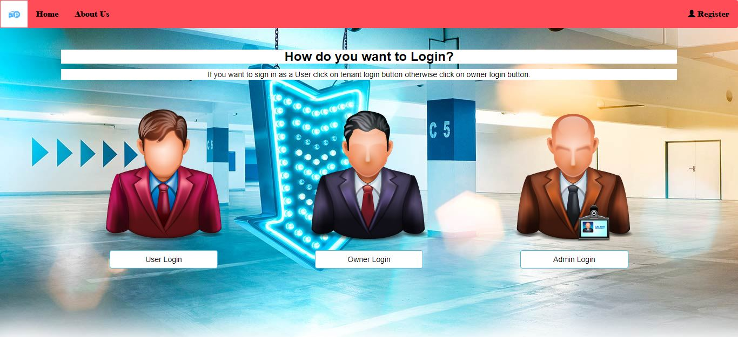
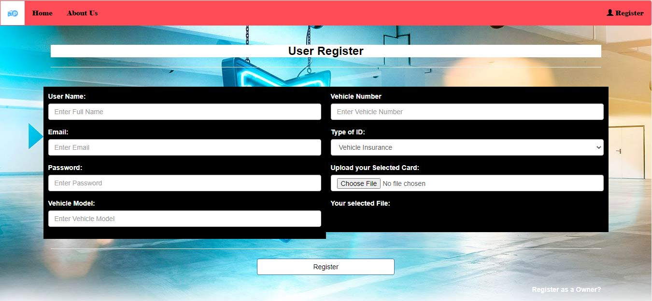
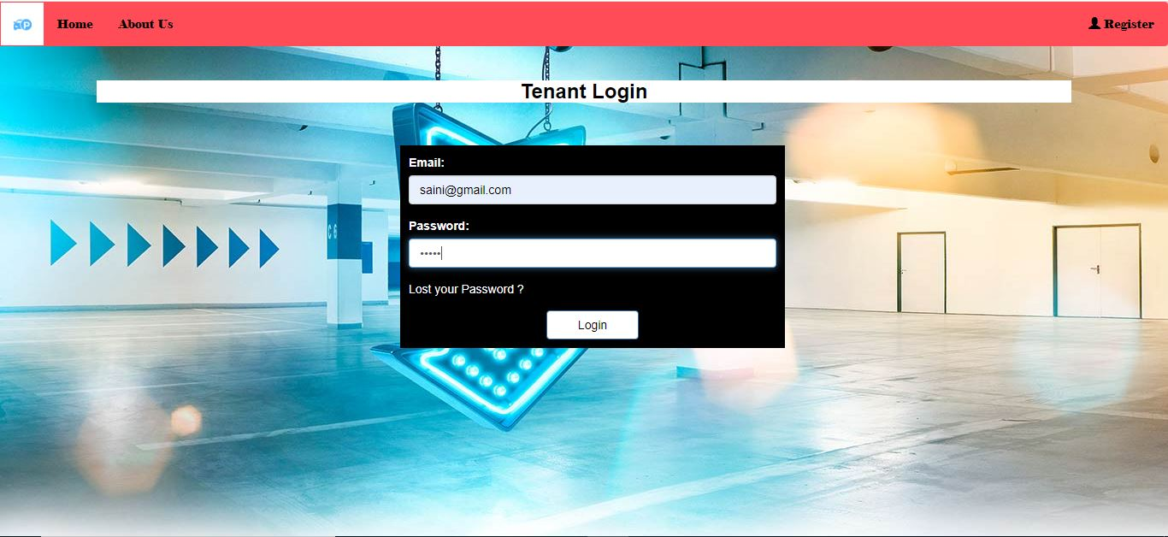
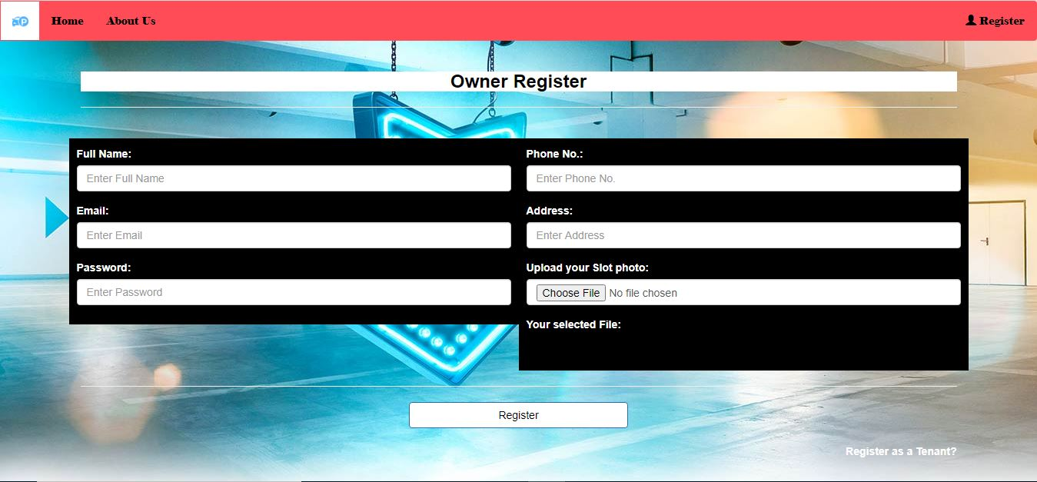
SCREENSHOTS

Slide 20
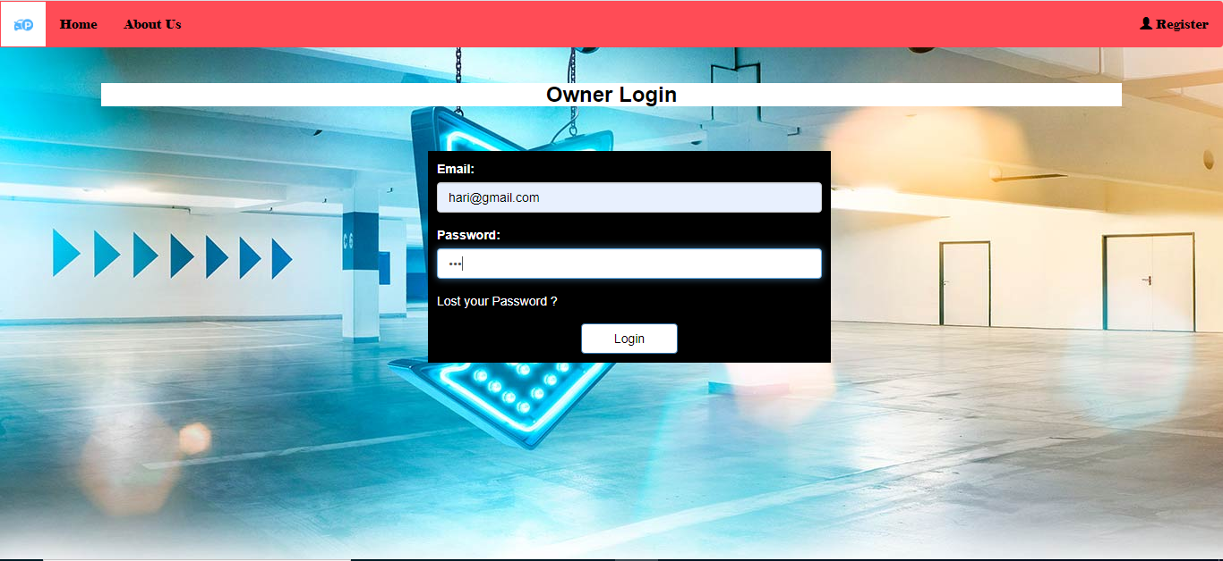
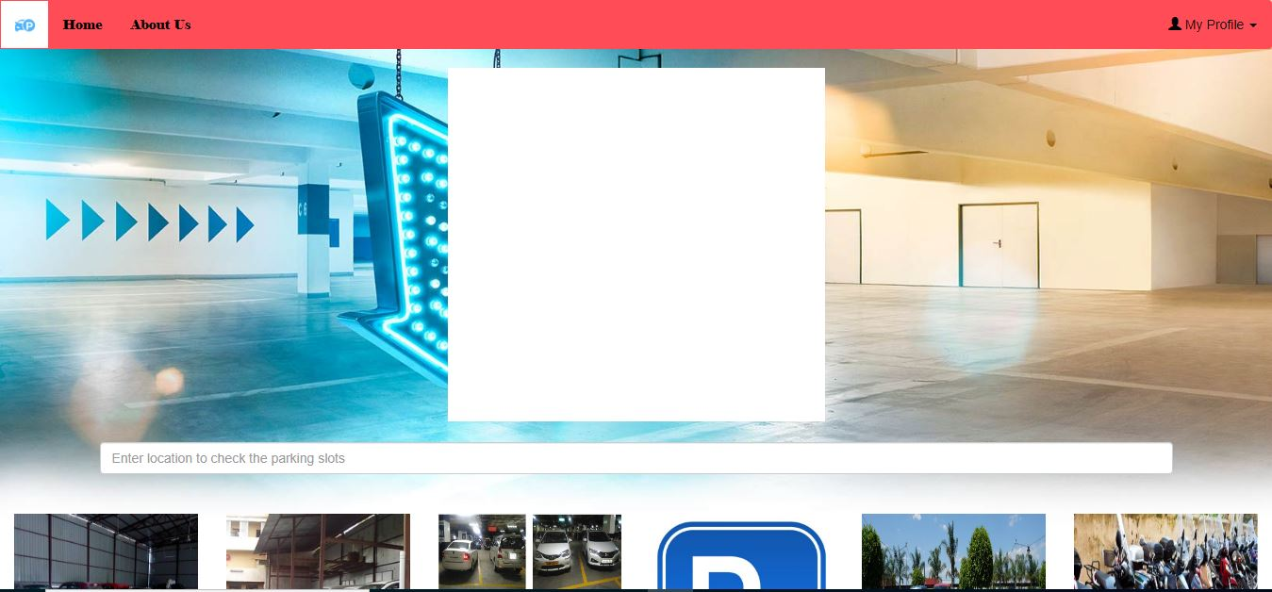
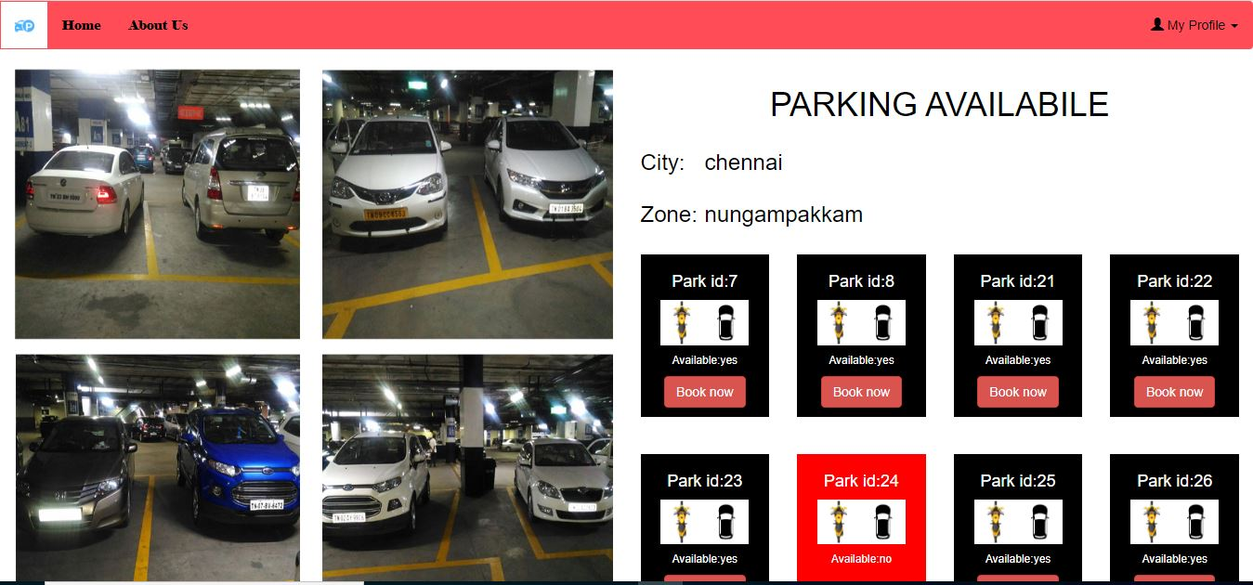
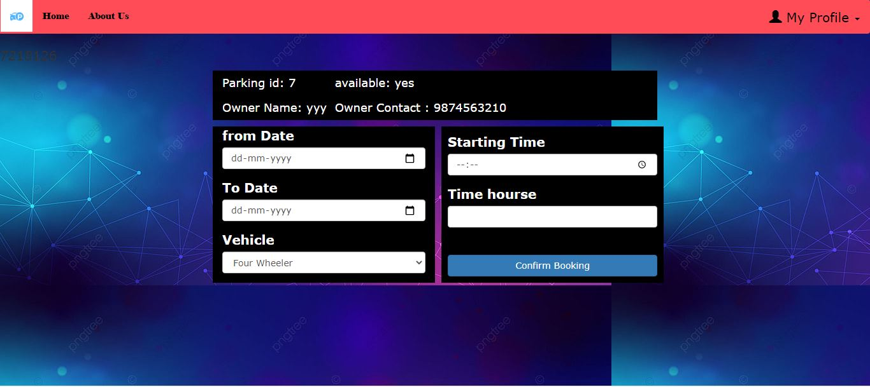

Slide 21
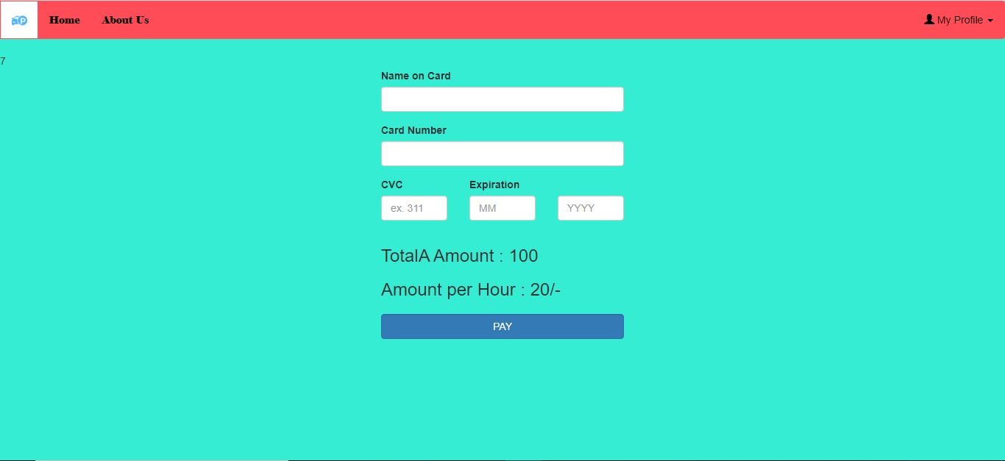

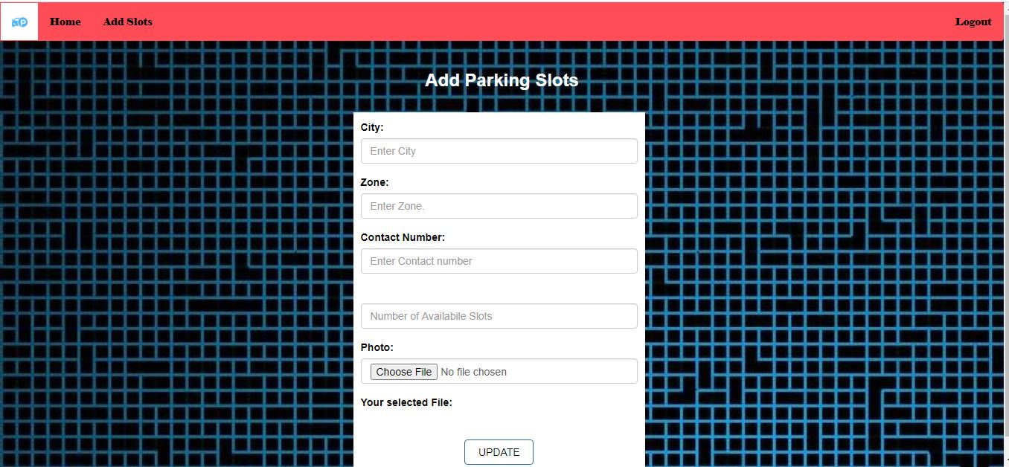
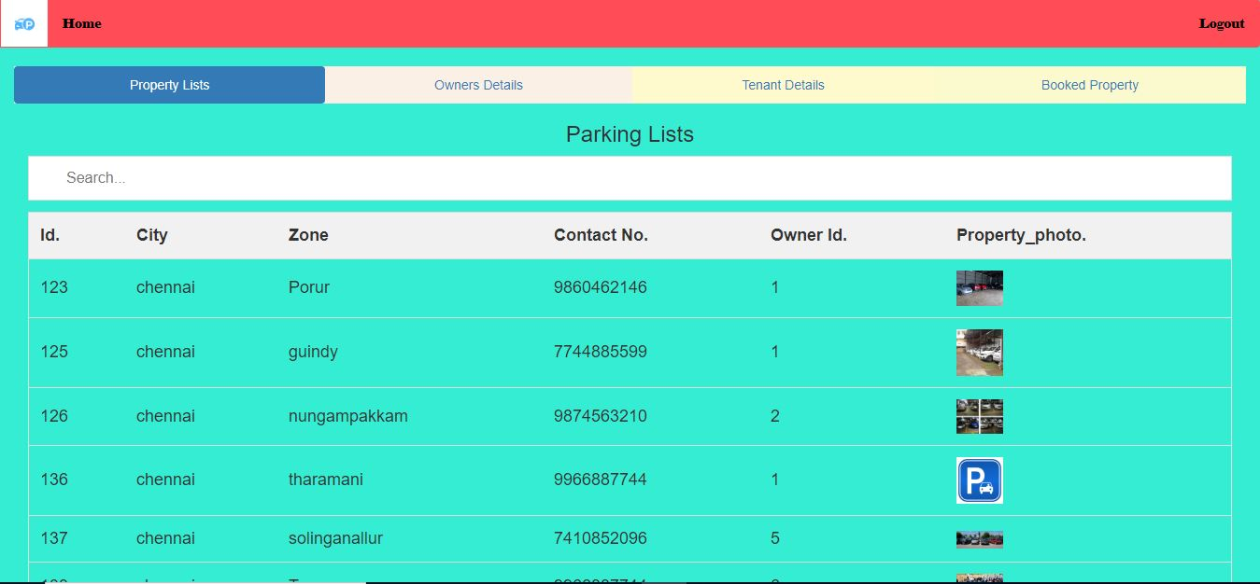

Slide 22
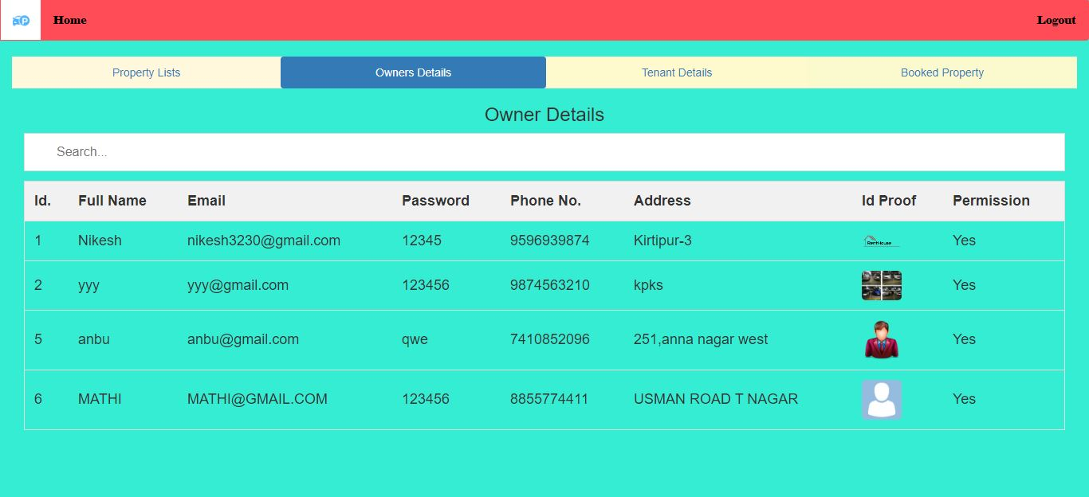
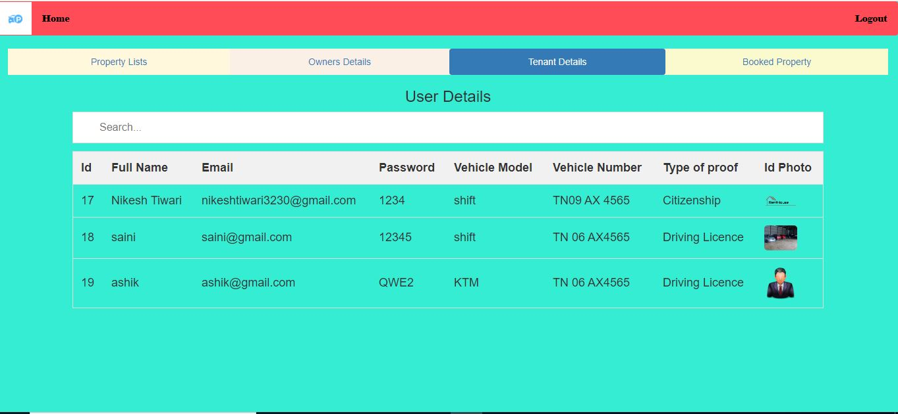
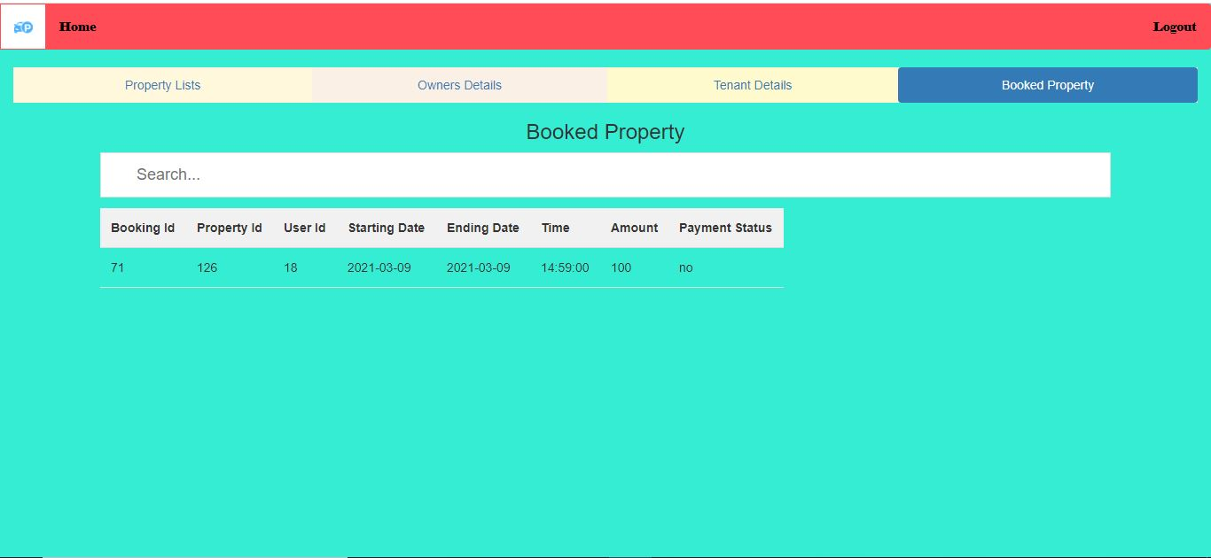
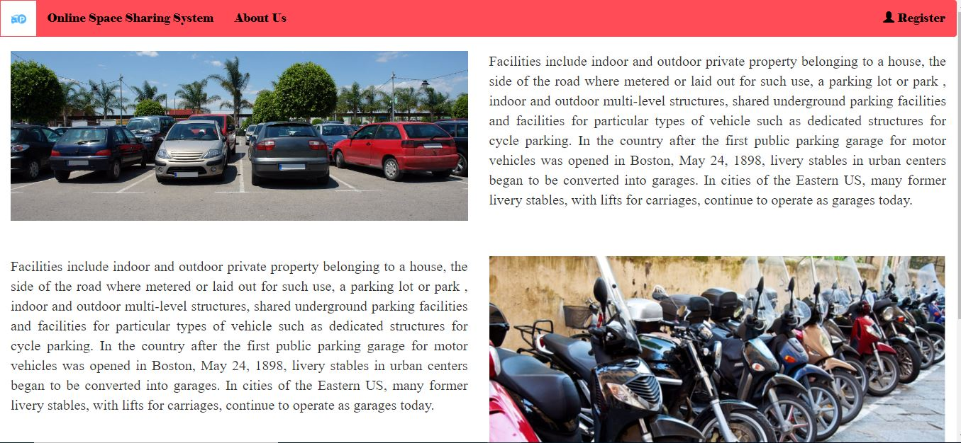

Slide 23
CONCLUSION
This shared parking allocation problems between parking demands in commercial buildings and parking supplies in residential zones. The concept of shared parking is proposed, which is according to the preconditions of shared parking implementation. Then, the feasibility of shared parking between parking requests from commercial buildings and private paid or public free parking lots in residential zones is initially evaluated by analyzing the characteristics of shared parking, which include win-win, convenience, economy, and real-time performance. Next, a bitrate parking spaces allocating model involving the minimum walking distance and the maximum utilization is proposed. The model comprehensively considers the drivers’ walking distance and the utilization of parking spaces. It not only receives reception requests for buildings in commercial zones, but also assigns them to corresponding vacant parking lots in accordance with the model hypothesis and parking space-time constraints. PSO algorithms applied to solve the parking allocation model.

Slide 24
REFERENCES
[1] R. Carli, M. Dotoli, and R. Pellegrino, “A hierarchical decision-making strategy for the energy management of smart cities,” IEEE Trans. Autom. Sci. Eng., vol. 14, no. 2, pp. 505–523, Apr. 2017.
[2] R. Schlegel, C.-Y. Chow, Q. Huang, and D. S. Wong, “User-deﬁned privacy grid system for continuous location-based services,” IEEE Trans. Mobile Comput., vol. 14, no. 10, pp. 2158–2172, Oct. 2015.
[3] Finding Out All the Parking Spaces in Beijing. Accessed: Sep. 16, 2017. [Online]. Available: https://www.sohu.com/a/192479755_683886
[4] S. M. Nir, “Car-share companies get coveted parking in New York City,” New York Times. Accessed: May 31, 2018. [Online]. Available: https://www.nytimes.com/2018/05/31/nyregion/nyc-zipcar-parking.html
[5] X. T. R. Kong, S. X. Xu, M. Cheng, and G. Q. Huang, “IoT-enabled parking space sharing and allocation mechanisms,” IEEE Trans. Autom. Sci. Eng., vol. 15, no. 4, pp. 1654–1664, Oct. 2018.
[6] O. T. T. Kim, N. H. Tran, C. Pham, T. LeAnh, M. T. Thai, and C. S. Hong, “Parking assignment: Minimizing parking expenses and balancing parking demand among multiple parking lots,” IEEE Trans. Autom. Sci. Eng., vol. 17, no. 3, pp. 1320–1331, Jul. 2020.
[7] C. M. A. for Planning. Parking Strategies to Support Livable Communities. Accessed: May 2012. [Online]. Available: https://www.slideshare.net/lindsaybanks/parking-strategies-to-supportlivable-communities-12836141.
[8] R. Carli, M. Dotoli, and R. Pellegrino, ―A hierarchical decision-making strategy for the energy management of smart cities,‖ IEEE Trans. Autom. Sci. Eng., vol. 14, no. 2, pp. 505–523, Apr.2017.

Slide 25
[9] R. Schlegel, C.-Y. Chow, Q. Huang, and D. S. Wong, ―User-defined privacy grid system for continuous location-based services,‖ IEEE Trans. Mobile Comput., vol. 14, no. 10, pp. 2158–2172, Oct. 2015.
[10] Finding Out All the Parking Spaces in Beijing. Accessed: Sep. 16, 2017. [Online]. Available: https://www.sohu.com/a/192479755 6 83886
[11] S. M. Nir, ―Car-share companies get coveted parking in New York City,‖ New York Times. Accessed: May 31, 2018. [Online]. Available: https://www.nytimes.com/2018/05/31/nyregion/nyc- zipcar-parking.html
[12] X. T. R. Kong, S. X. Xu, M. Cheng, and G. Q. Huang, ―IoT-enabled parking space sharing and allocation mechanisms,‖ IEEE Trans. Autom. Sci. Eng., vol. 15, no. 4, pp. 1654–1664, Oct. 2018.
[13] O. T. T. Kim, N. H. Tran, C. Pham, T. LeAnh, M. T. Thai, and C. S. Hong, ―Parking assignment: Minimizing parking expenses and balancing parking demand among multiple parking lots,‖ IEEE Trans. Autom. Sci. Eng., vol. 17, no. 3, pp. 1320–1331, Jul. 2020.
[14] C. M. A. for Planning. Parking Strategies to Support Livable Communities. Accessed: May 2012. [Online].
[15] Lin, T.; Rivano, H.; Le Mouel, F. A Survey of Smart Parking Solutions. IEEE Trans. Intell. Transp. Syst. 2017, 18, 3229–3253. [CrossRef]
[16] Vancluysen, K.; Boras, K. Smart Parking in the Thinking City; Technical Report; 2016. Available online: http://content.yudu.com/Library/A3zuy2/SmartParkingInTheThi/resources/index.htm(accessed on 5 October 2019). 15. Geng, Y.; Cassandras, C

